Slide 1

HULAFIT Mental Health Awareness sian devlin

Slide 2
TOPICS
What is Mental Health?
Common Mental Illness and Statistics
Communication Skills
Crisis Management and De-escalation
Managing Risk – Adult Safeguarding
Lone Working
Health Promotion and Signposting

Slide 3


What is Mental Health?
World Health Organisation (2014)
“Mental health is defined as a state of well-being in which every individual realizes his or her own potential, can cope with the normal stresses of life, can work productively and fruitfully, and is able to make a contribution to her or his community.”

Slide 4

How many people in the UK will experience a mental illness every year?
1 in 4

Slide 5

Brainstorm mental illnesses – as many as possible
OCD
PTSD
Personality disorders - borderline, narcissistic, histrionic, antisocial, paranoid
Eating Disorders – obesity, anorexia nervosa, bulimia nervosa
Suicidal Ideation / Attempts
Self Harm
Drug and Alcohol Use
Stress
Insomnia
Depression
Major depression
Dysthymia (recurrent mild depression)
Bipolar Disorder
Schizophrenia
Psychosis
GAD
Panic disorder
Social Anxiety
Agoraphobia
Notes:
https://www.maxpixel.net/Mental-Health-Tree-Branches-Brain-Thinking-Disorder-2313430

Slide 6
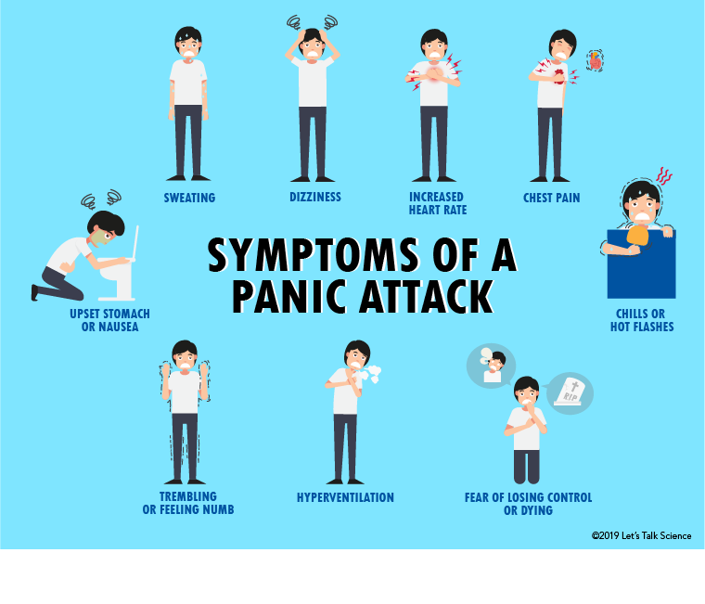
ANXIETY - PANIC ATTACKS
How to respond to a panic attack?
Try to stay calm
Gently let them know that you think they might be having a panic attack and that you are there for them
Encourage…
Slow and Deep Breathing–repetition can help focus e.g. counting out loud to 5, or asking them to watch while you gently raise your arm up and down
Sit somewhere quietly -where they can focus on their breath until they feel better.
Stamp feet on the spot - some people find this helps control their breathing.
Try grounding techniques - Focus on your senses.
You should never encourage someone to breathe into a paper bag during a panic attack. This isn't recommended and it might not be safe.

Slide 7
What is Schizophrenia?
Schizophrenia is a distorted sense of reality
Characterised by Positive and Negative Symptoms
Psychosis – Hallucinations and Delusions
Not Multiple Personality Disorder
Accept that their experience of the voices is real
Do not agree with delusions – use distraction techniques

Slide 8
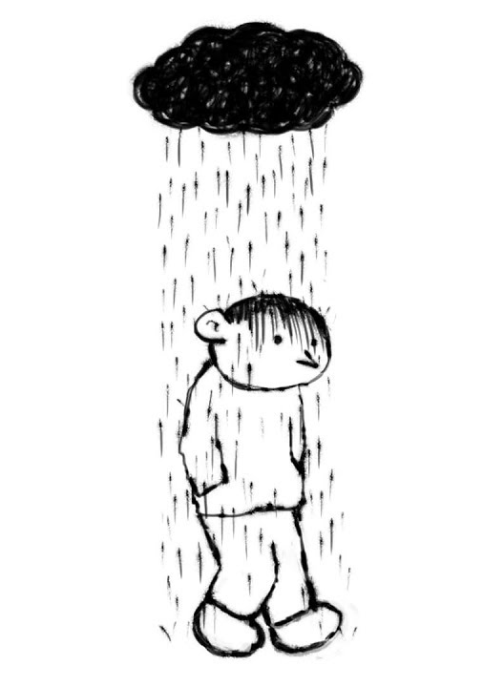
Depression
DSM-5 Diagnosis
Five or more symptoms during the same 2-week period
At least one of the symptoms should be:
1- Depressed mood
2 - Loss of interest or pleasure
Significant distress or impairment in social, occupational functioning
Not be a result of substance abuse or another medical condition.
1. Depressed mood
2. Diminished interest or pleasure in activities
3. Appetitive / Weight Changes
4. A slowing down of thought and a reduction of physical movement
5. Fatigue
6. Feelings of worthlessness or guilt
7. concentrate, or indecisiveness
8. Suicidal Ideation

Slide 9
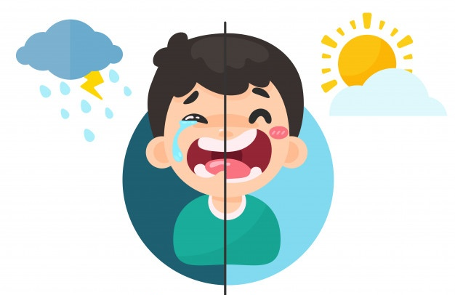
Bipolar Mental Health Foundation (2019)
About 1 in every 100 adults have bipolar disorder at some point in their life with the majority of people developing this condition between the ages of 15-19 (Mental Health Foundation, 2019)
Low Phase (or depressive) – depression, hopeless, despair, lethargic, full of self-blame and self-doubt, concentration difficulties, social withdrawal, suicidal ideation
High phase (mania or hypomania) – hyperactive, reduced sleep, faster talking, rapid thought, grandiose ideas or delusions, loss of judgement, risk taking behaviours
Rapid Cycling
BPD

Slide 10
BORDERLINE PERSONALITY DISORDER (BPD) - SYMPTOMS
BPD is a type of personality disorder:
Fluctuating Emotions / Mood Changes
Impulsivity
Worry about being abandoned
Sense of self can change significantly
Feelings of emptiness
Risk Taking
Intense feelings of anger
Paranoia and Dissociation
Try to be patient.
Don't judge.
Be calm and consistent.
Help remind them of all their positive traits - When someone is finding it hard to believe anything good about themselves, it can be reassuring to hear all the positive things you see in them.
Try to set clear boundaries and expectations - Feeling insecure about being rejected or abandoned may be common - it can be helpful to make sure you both know what you can expect from each other.
Plan ahead - When the person you're supporting is feeling well, ask them how you can help them best when things are difficult.

Slide 11

Early Warning Signs of Agitated Behaviour
Raised Voices
Body Language
Aggression
Verbal Communication e.g. threats
Language e.g. swearing
Pacing
Posture
Gesticulation
Fast Paced Speech
Shouting
Crying

Slide 12

Communicating with a distressed person -
De-escalation
Risk Assess – your safety (environment, risk)
Exit – Evacuation Plan
Hula Hoop – Neutral Place
Eye contact – but not staring
Do not speak over somebody shouting
Remain calm, neutral, listen attentively and reassure
Allow Venting - Let them share as much, or as little, as they want to
Acknowledge the anger
Ask them to explain their feelings
Open, friendly body language
Personal Space – Physical Distance
Do not back person into corner / yourself
Solution Focused
Self awareness
Other persons
Police
Avoid taking control or committing yourself to doing more than you are comfortable with
1) Validate – acknowledge and recognise feelings
2) Allow for choice – recognise freedom of choice,

Slide 13

A HulaFit Client says they want to talk to you about something serious but you can’t tell anybody…
What do you say?
“You can maintain confidentiality unless there is imminent risk of harm to themselves, another person or illegal activity disclosed.”

Slide 14
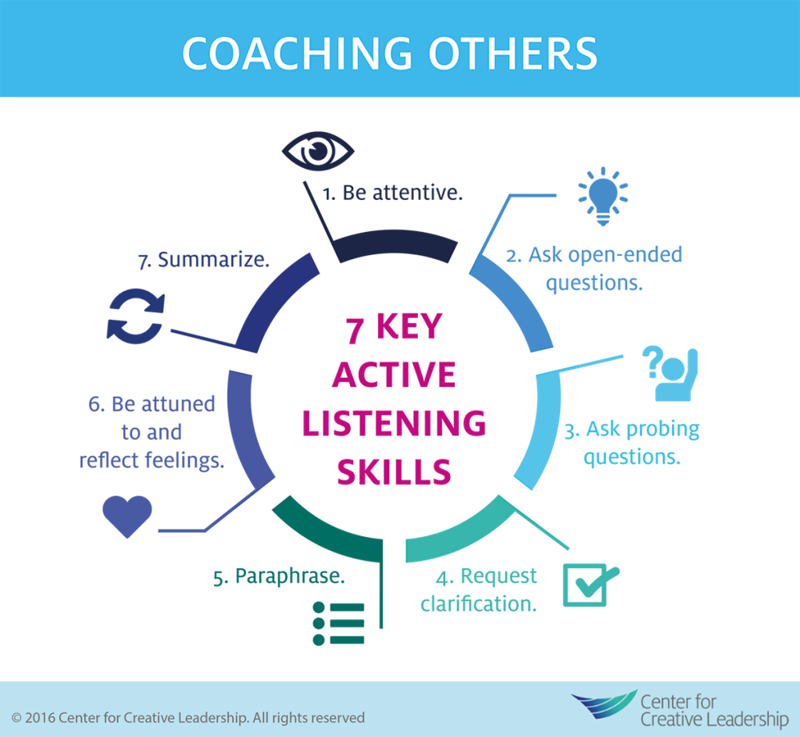
What are the 7 Skills in Active Listening?

Slide 15
SOLER (Egan 1975)
Sit Squarely
Open Posture
Lean towards the other
Sit opposite your partner, facing them.
Eye Contact
Relax
Uncross arms and legs
A good way of showing interest
Good eye contact – but don’t stare!
Maintain personal/cultural sensitivity
Don’t fidget or perform other activities simultaneously

Slide 16
Scenario one
In a conversation with a HulaFit Client they disclose they are having suicidal thoughts.
What do you do?

Slide 17

Emergency situations
Imminent risk of Harm - Plan, Means and Intent
Emergency Services (999) In first instance
Environmental Triggers or Hazards – Risk to Health Safety
Should you tell the person what you are going to do?
Data Protection Act – GDPR -Information can only be shared on ‘need to know’ basis unless there is an imminent risk of harm.

Slide 18
Definition of Safeguarding
Safeguarding means protecting an adult’s right to live in safety, free from abuse and neglect.
A person at risk or a vulnerable adult is described by ‘The Adult Care Act 2014’ as an individual over the age of 18:
“who has needs for care and support (whether or not the local authority is meeting any of those needs) and is experiencing, or at risk of, abuse or neglect and as a result of those care and support needs is unable to protect themselves from either the risk of, or the experience of abuse or neglect.”
Safeguarding means protecting an adult’s right to live in safety, free from abuse and neglect.
It is about people and organisations working together to prevent and stop both the risks and experience of abuse or neglect, while at the same time making sure that the adult’s wellbeing is promoted including, where appropriate, having regard to their views, wishes, feelings and beliefs in deciding on any action.
This must recognise that adults sometimes have complex interpersonal relationships and may be ambivalent, unclear or unrealistic about their personal circumstances. (DOH, 2014)

Slide 19
Types of Abuse
Physical
Sexual
Psychological
Neglect
Discriminatory
Financial
Institutional
Adult safeguarding has an extra 3 categories

Slide 20
Consider What May Make an Injury Suspicious?
Position of injury
Delayed disclosure
Inconsistent history
No adequate explanation
Doesn’t fit injury
Changing history with time/person
Age or disability appropriate

Slide 21
Responsibilities in safeguarding
Everybody’s responsibility
Report to the local Social Services department as per the local policies and procedures for their area
Consider informing the local Police
Disclosure:
Who, when, why, what, where?
When someone tells you about that they have been abused, it is important that you do not:
Stop them recalling significant events: allow them to share whatever is important to them
Show signs of shock or disbelief
Contact the abuser
Promise to keep secrets
Be judgemental (“why didn’t you stop them?”)
Chapter 14 of the Care Act Guidance covers safeguarding adults https://www.gov.uk/government/publications/care-act-statutory-guidance/care-and-support-statutory-guidance
National Domestic Violence Helpline- 0808 200 0247
Women's Aid (womensaid.org.uk)

Slide 22
7 golden rules of information sharing
Be
open and honest
GDPR
Seek advice
Necessary
Proportionate relevant accurate
timely secure
Consider safety
and
well being
Record your decisions
and
reasons
Data Protection (2018)
Necessity – Need to Know
Confidentiality Clause
Justifiable
Proportionate (relevant)
Share with
consent
Notes:
1. Data Protection Act is not a barrier to sharing information
2. Be open and honest with the person or family
3. Seek advice if you are in any doubt
4. Share with consent where appropriate
5. Consider safety and well being – of the person and others who may be affected by their actions
6. Necessary. Proportionate, relevant, accurate, timely, and secure
7.Keep a record of your decisions and reasons

Slide 23
Documentation
Time and Date
Objective (facts)
Avoid subjectivism
Timely
PDF
Password Protect
Email copy

Slide 24
What is Prevent?
Section 26 of the Counter Terrorism and Security Act placed a statutory duty on a number of specified authorities (including the health sector) to have ‘due regard’ to prevent people being drawn into terrorism.
This is the ‘Prevent Duty’.
Prevent is part of the UK’s Counter Terrorism Strategy known as CONTEST.
Prevent works to stop individuals from getting involved or supporting terrorism or extremist activity.

Slide 25
What are your responsibilities?
Notice – use professional judgement to pick up on any ques / recognise signs and symptoms of radicalisation. Think and consider safeguarding.
Check – Check concerns with management, Prevent Lead, Safeguarding Lead.
Share – Share the information with appropriate partners (differs according to local authorities).
Remember -You do not have to make any decisions alone. Trust your professional instinct and voice your concerns
Know your responsibilities
Know your policies and procedures
Know who to contact
Remember to follow your local and national guidance on information sharing.

Slide 26
Useful Numbers - prevent
101 - designed to encourage people to make contact with the police at an early stage to prevent or detect crime. In terms of Prevent, the earlier authorities can be involved the greater the chance we can intervene with partners and stop someone from being radicalised
0800 789 321 you are suspicious that someone is being radicalised or that the call is terrorism related you can call the confidential anti-terrorist hotline https://secure.met.police.uk/athotline
999 - In an emergency where you feel that there is an immediate terrorist threat.
If
.

Slide 27
Scenario two
You are collecting in Hula Hoops and notice one of your clients has cuts on their arms appears to be self-harm.
What do you do?

Slide 28
Signposting – See Signposting List
IAPT
Low Level – GP (Primary Care)
Mental Illness / Sever- Enduring / Complex Needs – Secondary Care

Slide 29
helplines
https://helplines.org/helplines/
Mind | 0300 123 3393 | www.mind.org.uk/
Sane | 0300 304 7000 | www.sane.org.uk
The Samaritans 24/7 Helpline: | Freephone 116 123 | https://www.samaritans.org/
National Suicide Helpline UK | Freephone 0800 689 5652 | https://www.gmmh.nhs.uk/
Papyrus Suicide Helpline (under 35): | Freephone 0800 068 4141 (9am – midnight week / 2pm – 10pm weekends) TEXT 07786 209697 | https://www.papyrus-uk.org/
Shout is a 24/7 text service for anyone in crisis anytime, anywhere. | Shout to 85258 | https://giveusashout.org/
CALM is the Campaign Against Living Miserably | 0800 58 58 58 (daily, 5pm to midnight) | https://www.thecalmzone.net/

Slide 30
Mindfulness RESOURCES
Free Mindfulness Based Stress Reduction Course Online MBSR/Mindfulness (Free) (palousemindfulness.com)
Mindfulness for Students Mindfulness for Students
Hedspace have run a series on Meditation currently on Netflix Headspace Guide to Meditation | Netflix Official Site
Free Meditations https://franticworld.com/free-meditations-from-mindfulness/
Mental Health Podcast https://www.mentalhealth.org.uk/podcasts/stress-and-relaxation-quick-fix-breathing-exercise
Apps
Insight Timer (Free)
Smiling Mind (Free)
MyLife Meditation (Free)
Healthy Minds Program (Free)
Calm
Hedspace

Slide 31

boundaries
Notes:
Putting boundaries in place could include:
Having specific time just for you – for example “I really need to do well in this module, so I’m going to spend the afternoons in the library. It is really important for me that I do this.”
Encouraging your friend to build a wider support network – “I’m worried that I’m not always going to be around when you need me, there are other people we can talk to as well?”
Encouraging your friend to seek more support – “It sound like this is really difficult, I’m not sure if I’m the best person to help on my own. I wonder if we could also get someone else with more experienced to help?”
Putting your won priorities first – “Thanks for texting me. Sounds like this is a difficult day. I really want to help. I have an essay due in tomorrow so can we meet for coffee tomorrow afternoon?”

Slide 32

Any Questions?

